Slide 1




DEPARTMENT OF UNIVERSITY OF COMNPUTING CHANDIGARH UNIVERSITY
FINAL PROJECT REPORT
Title:PowerVacc3000-CleanSweepVaccums
Submitted By:
Name:Lakshit Negi
UID:24BCA10623
Section:24BCA-1(A)
Sumbitted to:
Name:Mrs.Konika Grover
Subject:Web Designing
Subject Code:24CAH153

Slide 2
Acknowledgement
I would like to express my gratitude to all those who have helped in the completion of this project.
First and foremost, I am deeply grateful to Ms. Konika Grover, whose guidance, feedback, and continuous encouragement were invaluable throughout the project. Their expertise and insights have been instrumental in shaping the direction and outcome of this work.
I also extend my thanks to Chandigarh University/ UIC for providing the necessary resources and a conducive environment to carry out this project.
Lastly, I would like to thank my teacher for their unwavering support and understanding, without which this project would not have been possible.
Name:Lakshit Negi
Ayan Mokal
UID:24BCA10623
24BCA10012
Date:16-042025

Slide 3
🌟 Introduction to the Vacuum Cleaner Website – CleanSweep Vacuums
Welcome to CleanSweep Vacuums, a modern and stylish web platform designed to showcase and promote a premium range of vacuum cleaners. This website is tailored for users looking for efficient, affordable, and high-performance cleaning solutions for their homes or workplaces.
🧼 Purpose
The main objective of this webpage is to present vacuum cleaner products in a visually appealing and informative manner, helping potential customers explore features, compare options, and make confident purchasing decisions. It highlights three primary product models, catering to various user needs such as power, portability, and smart automation.
🎨 Design Features
Clean and Responsive Layout: The website uses a soft, gradient background and card-based layout that is fully responsive across devices—from mobile phones to desktops.
Engaging Header: The page opens with a bold and friendly header including the brand name CleanSweep Vacuums and a short tagline that communicates the value proposition.
Product Showcase: Each vacuum cleaner is displayed in an elegant card with:
Name and model
Key features/description
Price
Call-to-action “Buy Now” button
Footer: A minimalistic footer reminds users of the brand’s presence and includes copyright.

Slide 4
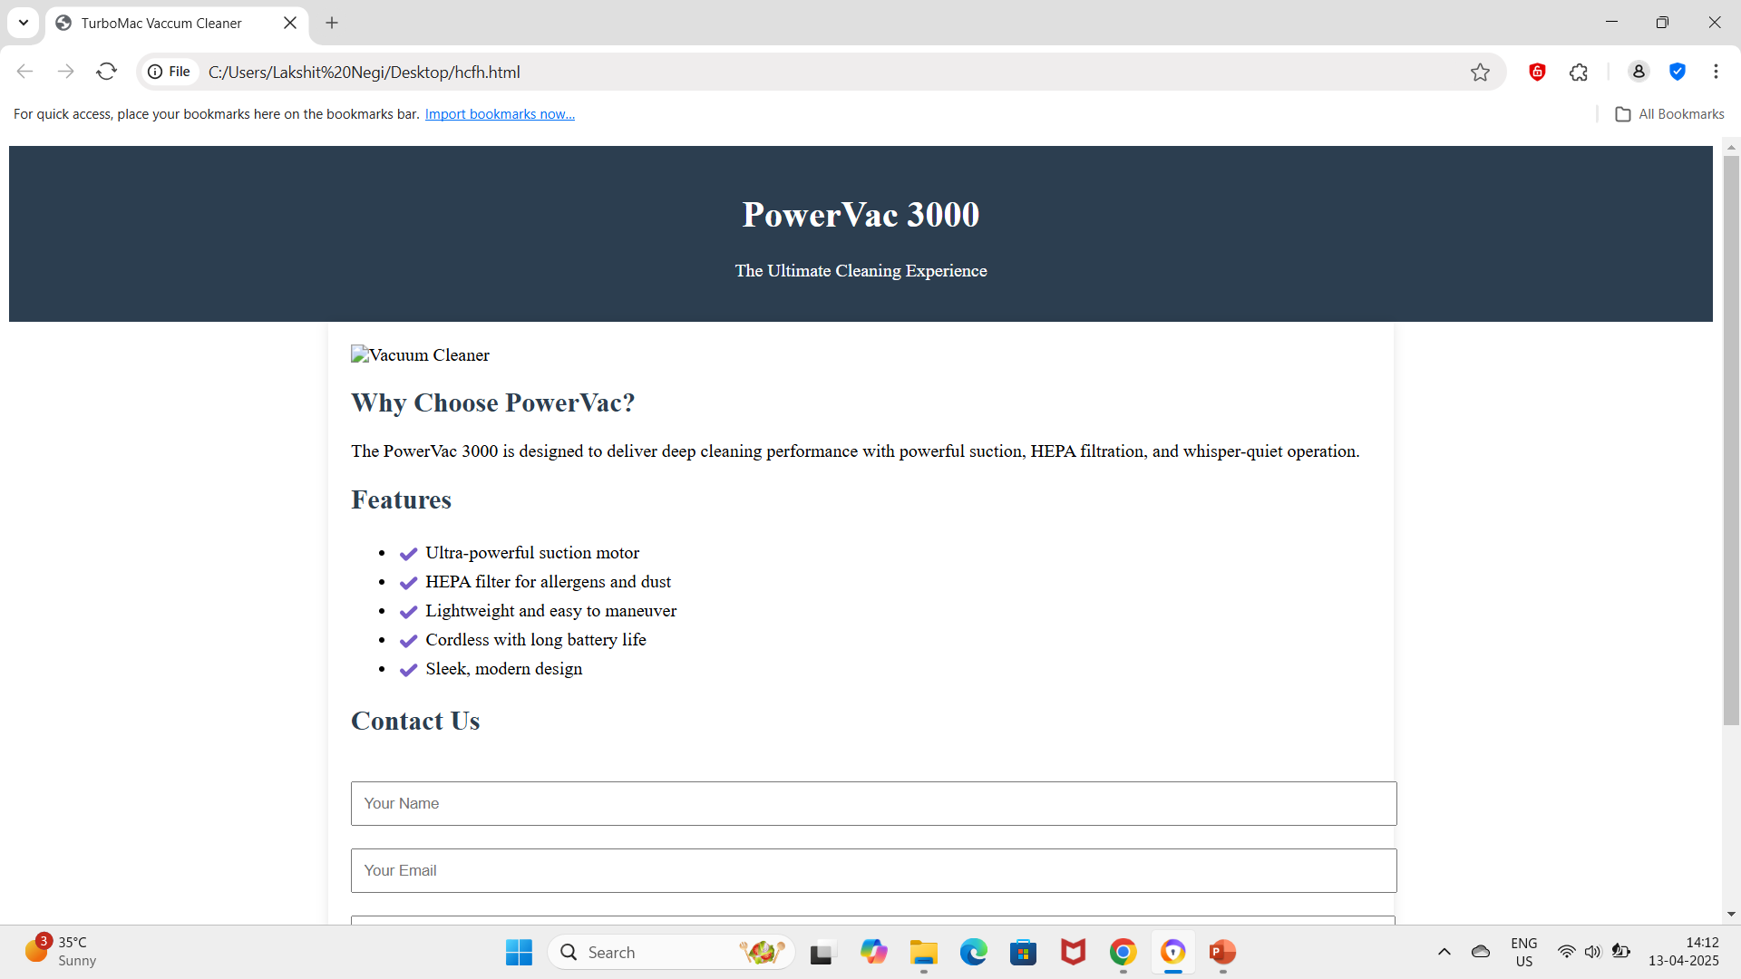
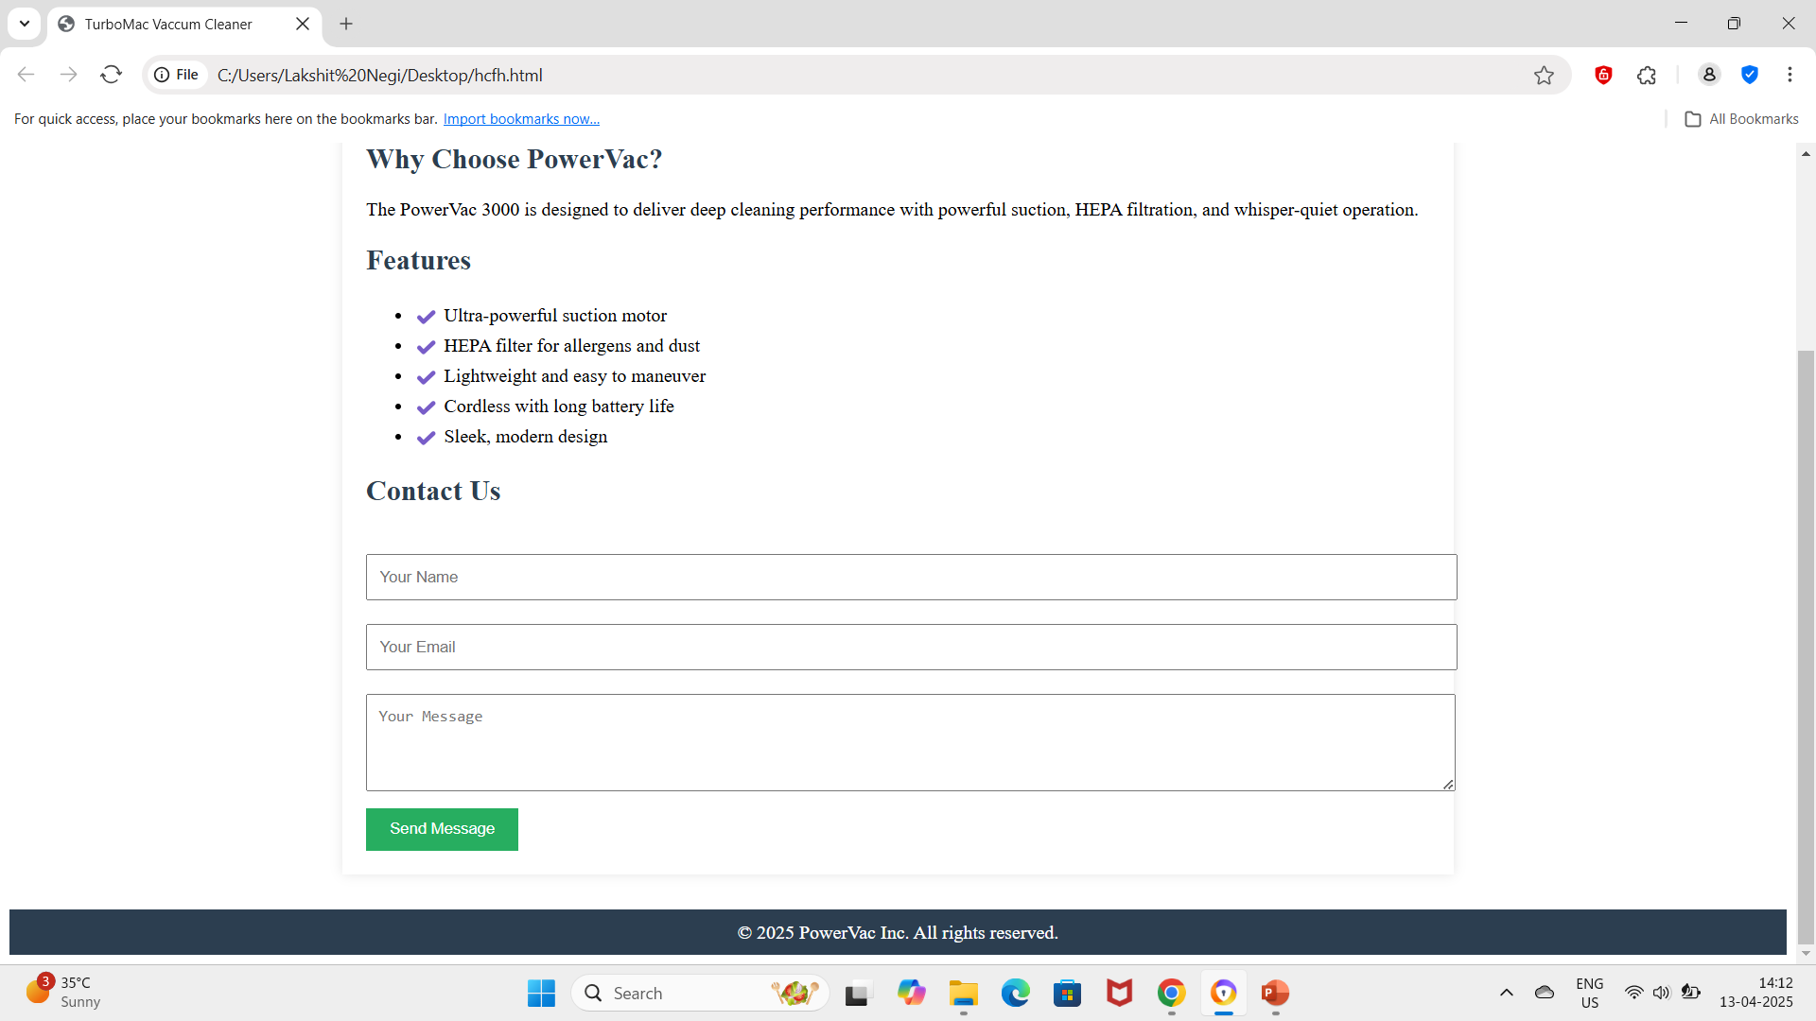
Screenshots

Slide 5
✅ Conclusion
The CleanSweep Vacuums website is a sleek, user-friendly platform that effectively combines modern design with practical functionality. It offers a clear and attractive presentation of top vacuum cleaner models, making it easy for customers to explore features and take action.
Whether you're a busy parent, a pet owner, or simply someone who values a clean home, CleanSweep provides tailored solutions to meet every need. With its clean layout, responsive design, and strong call-to-actions, this site is built not just to inform—but to convert.
As the brand grows, the website can easily scale with new features like customer reviews, smart filters, and online checkout, making it a strong foundation for digital success.

